Slide 1
Enhancing Communication For Deaf Individuals: A Sign Language Translation
PRESENTED TO:
Dr. Lamiaa
PRESENTED BY:
Alia Medhat
Malak Mahmoud Aref
Nouran Mohamed
Aya Abdelmoneim

Slide 2
TABLE OF CONTENTS
[1] INTRODUCTION
[4] SIGN LANGUAGE RECOGNITION PROCESS
[8] CHALLENGES & FUTURE WORK
[9] CONCLUSION
[2] BACKGROUND
[3] PROJECT OVERVIEW
[7] DEMO
[5] MODEL TRAINING
[6] RESULTS & PERFORMANCE EVALUATION

Slide 3
INTRODUCTION
01
Overview of the project
Importance of sign language recognition
Objective of the project

Slide 4
INTRODUCTION
OVERVIEW OF THE PROJECT:
- This project focuses on the development of a real-time Arabic sign language recognition system using Python. With the increasing prevalence of technology in our daily lives, it's essential to ensure that communication accessibility is extended to all individuals, including those who rely on sign language as their primary means of communication.
- By leveraging computer vision techniques and machine learning algorithms, our system aims to bridge the communication gap for the deaf and hard of hearing community by providing an intuitive and efficient tool for sign language recognition.

Slide 5
ANALYSIS
IMPORTANCE OF SIGN LANGUAGE
- Sign language serves as the primary mode of communication for millions of deaf and hard of hearing individuals worldwide.
- However, the lack of widespread understanding of sign language poses significant challenges to effective communication and social integration for this community.
- Recognizing and interpreting sign language in real-time can greatly enhance accessibility and inclusivity, enabling seamless communication between deaf individuals and the broader community
Deaf
Blindness

Slide 6
466,000,000
people worldwide with disabling hearing loss, which is about 6.1% of the world's population.

Slide 7
BACKGROUND
02
Brief Introduction To Arabic Alphabet Sign Language (ArAsl)

Slide 8
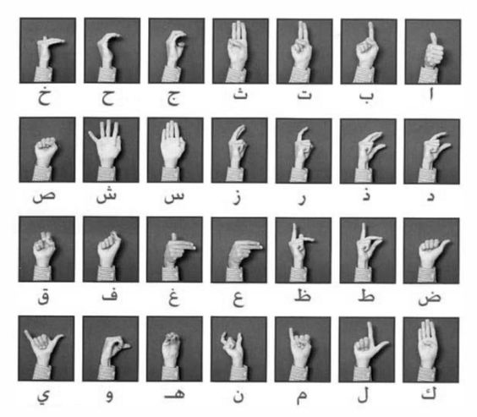
ArAsl: Arabic Alphabet Sign Language
The ARASL dataset is designed to support research and development in the area of Arabic sign language recognition.
It provides a standardized collection of sign language gestures and expressions, enabling researchers and developers to train and evaluate machine learning models for sign language recognition tasks.
The ARASL dataset can be used in various applications related to Arabic sign language recognition, including the development of real-time sign language translation systems

Slide 9
PROJECT OVERVIEW
03
Description of the real-time Arabic sign language recognition system
Technologies used .
Goals and objectives of the project

Slide 10

Description Of The Real-Time Arabic Sign Language Recognition System
By using state of the art technologies, the system will be capable of accurately interpreting Arabic sign language gestures and expressions in real-time, enabling seamless communication between deaf individuals and the broader community.
Leveraging computer vision techniques and machine learning algorithms, the system will analyze live video input to recognize and translate sign language gestures into written or spoken language, providing deaf individuals with enhanced accessibility and communication capabilities.

Slide 11
TECHNOLOGIES USED
Support vector machines for training models to recognize sign language gestures from video input data.
the primary development platform for implementing the sign language recognition system.
OPENCV
MEDIAPIPE
PYTHON
SVM
Computer vision library that provides functionalities for image and video processing and feature extraction, and gesture recognition.
Framework used to monitor key points by analyzing video frames and identifying a person's pose, hands, and face landmarks.

Slide 12
GOALS & OBJECTIVES
Accessibility
Accuracy
Real Time Performance
To achieve high accuracy in recognizing and interpreting Arabic sign language gestures, ensuring reliable communication and minimizing misinterpretations.
To ensure that the system operates in real-time, providing instantaneous recognition and translation of sign language gestures without significant delays.
Develop a real-time Arabic sign language recognition system that enhances accessibility and communication for deaf individuals

Slide 13
04
SIGN LANGUAGE RECOGNITION PROCESS

Slide 14
SIGN LANGUAGE RECOGNITION PROCESS
PREPROCESSING OF INPUT DATA FRAMES
MACHINE LEARNING MODEL FOR CLASSIFICATION
FEATURE EXCTRACTION TECHNIQUES
REAL TIME IMPLEMENTATION USING PYTHON
Frame Esctraction, Noise Reduction, Normalization, Backgroud Sustraction
Support Vector Machines (SVMs)
Hands Detection, Hand Shape Analysis, Motion Analysis
Integration with OpenCV, Efficient Inference, Performance Optimization

Slide 15
MODEL TRAINING
05
Choice of machine learning algorithm
Training process and parameters
Model evaluation metrics

Slide 16
MODEL TRAINING
MACHINE LEARNING ALGORITHM | SVM |  | Effective for binary classification tasks and can be used to classify extracted features of sign language gestures into predefined categories
Training Process | Hyperparameter Tuning |  | Tuning the hyperparameters of the machine learning algorithm, such as learning rate, regularization strength, and network architecture, to optimize performance and prevent overfitting.
Model Evaluation Metrics | Accuracy, Precision & Recall, F1 Score, Confusion Matrix |  | These metrics provide valuable insights into different aspects of the model's performance, such as its accuracy, robustness, and ability to handle class imbalances

Slide 17
06
RESULTS & PERFORMANCE EVALUATION

Slide 18
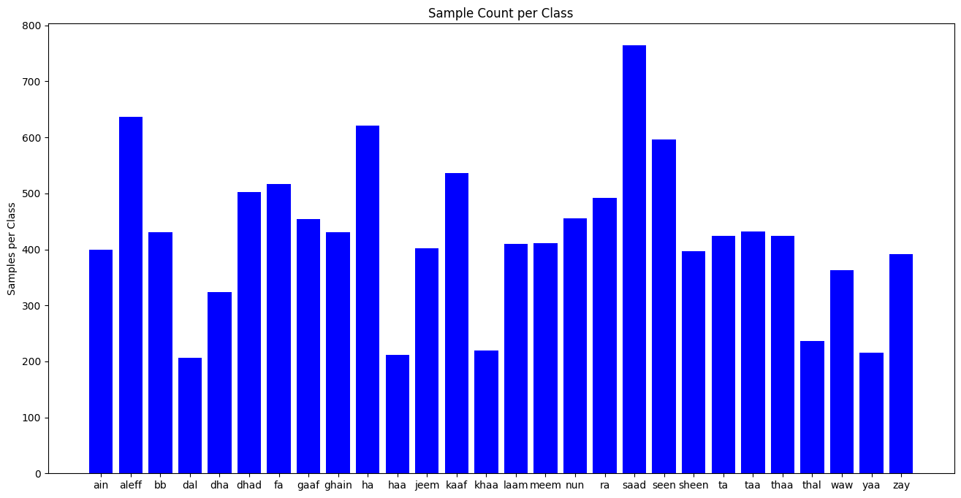
PERFORMANCE OF THE TRAINED MODEL
The performance evaluation involves:
Testing: Running the trained model on the test dataset, which contains unseen samples not used during training or validation.
Prediction: Generating predictions for each sample in the test dataset, indicating the recognized sign language gestures.
Evaluation Metrics: Calculating various evaluation metrics to quantify the model's performance, including accuracy, precision, recall, and F1 score.

Slide 19
07
DEMO
Live Demonstration of the real time sign language system
Sneak Peek of The system’s capabilities

Slide 20
PROCEDURES
FRAMES INPUT
RECOGNITION & TRANSLATION
REAL-TIME PROCESSING
FEEDBACK & INTERACTION
The recognized sign language gestures will be displayed on the screen, either as text annotations or as spoken language output, depending on the system's configuration.
The live video feed will be displayed on the screen, showing the signer performing various sign language gestures.
As the signer performs each gesture, the sign language recognition system will analyze the video frames in real-time, extracting relevant features and classifying the gestures.
Interaction with the system by performing their own sign language gestures and observing how the system interprets and translates them in real-time.

Slide 21
08
CHALLENGES & FUTURE WORK
Challenges encountered during the project
Potential improvements and future enhancements

Slide 22
CHALLENGES ENCOUNTERED
DATA AVAILABILITY & QUALITY
COMPLEXION OF SIGN LANGUAGE
REALTIME PROCESSING CONSTRAINTS
FUTURE ENHANCEMENTS
DATA AUGMENTATION
Collecting more annotated data from diverse signers and environments can also enhance dataset diversity and quality
Limited availability of annotated Arabic sign language datasets may have posed challenges in training accurate and robust machine learning models.
MODEL OPTIMIZATION
Capturing and representing this complexity in a computational model may have presented challenges in feature extraction, classification, and interpretation.
Optimizing the machine learning models for improved accuracy, efficiency, and real-time performance
USER FEEDBACK & INTERFACE
Balancing accuracy with speed in real-time systems can be challenging.
Gathering feedback from deaf users, sign language interpreters

Slide 23
CONCLUSION
09
Summary of key findings
Importance of real-time sign language recognition

Slide 24
CONCLUSION
In Summary, the development has been a significant endeavor with several key findings:
The system demonstrates promising accuracy and efficiency in interpreting Arabic sign language gestures in real-time, showcasing its potential to facilitate communication accessibility for deaf individuals.
Through the integration of computer vision techniques and machine learning algorithms, the system effectively extracts and analyzes visual features from live video input, enabling accurate recognition and translation of sign language gestures.
The real-time Arabic sign language recognition system addresses a critical need for enhanced communication accessibility for the deaf and hard of hearing community.
Real-time sign language recognition not only facilitates direct communication between deaf and hearing individuals but also promotes inclusivity, diversity, and equal participation in society.

Slide 25
THANKS
Do you have any questions?
handspeak@alexu.com
+01 234 567 89
HANDSPEAK.com

